Slide 1

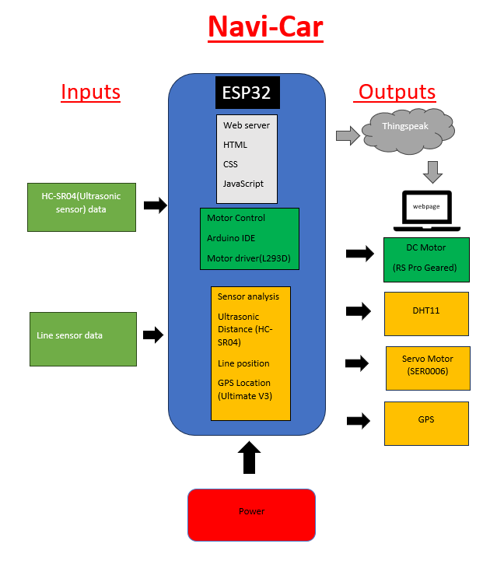
QR Code
here
Navi Car
2nd Year Internet of Things Project
Nathan Ferry
BEng)(Hons) Software and Electronic Engineering
Project Summary
Architecture Diagram
Hardware Used
The NaviCar is a self autonomous vehicle that utilises 2 SEN0017 line sensors to detect and follow a line. Two DC motors drive the chassis using an L293D motor driver with an ESP32 microcontroller. A DHT11 measures temperature and humidity and passes it to a website live. The temperature is also passed to the HC-SR04 ultrasonic sensor to calculate the NaviCar’s distance between itself and obstacles more accurately. A GPS also passes the live location of the NaviCar to the website. A Servo motor rotates the ultrasonic sensor in order for it to read the value on the NaviCar’s left and right.
DC Motors
GPS Ultimate V3
DHT11 Temperature & Humidity sensor
SEN0017 Line Sensors
L293D Motor Driver
ESP32
HC-SR04
Servo Motor
Sustainable Development Goals
Goal 3: The NaviCar targets the U.N. goal target 3.6 which is to half the number of road deaths and accidents by 2020. The NaviCar uses sensing technology to avoid collisions when moving forward.
Goal 11: Target 11.2 is to providing access to safe, affordable, accessible and sustainable transport systems as well as improve road safety for all. The NaviCar’s ability to follow a predetermined path leads to improved road safety.
Skills and Technologies
Hardware & Software Debugging
Logical problem solving
Visual studio code
3D Modelling/Printing
Arduino programming
Html/CSS
IoT analytics with Thingspeak
C/C++
Website Data

